Slide 1
Exercise
Is this an AVL tree?
Do not see the answer immediately.
  Try to solve it by yourself.
50
30
70
10
90
1

Slide 2
Solution
Yes, it’s an AVL tree because each node's balance factor is -1, 0, or 1.
  The red number next to each node is the balance factor of the node.
0
50
1
-1
30
70
0
0
10
90

Slide 3
Exercise
Is this an AVL tree?
Do not see the answer immediately.
  Try to solve it by yourself.
50
30
70
10
60
90

Slide 4
Solution
No, it’s not an AVL tree because it’s not a binary search tree.
  Pay attention to the node 60.
  In order to be an AVL tree, it must be a binary search tree in addition to meeting the balance factor requirements.
50
30
70
10
60
90

Slide 5
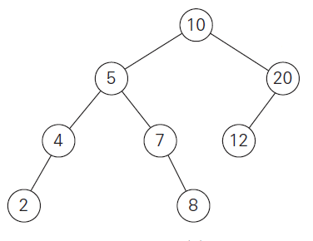
Exercise
Is this an AVL tree?
Do not see the answer immediately.
  Try to solve it by yourself.

Slide 6
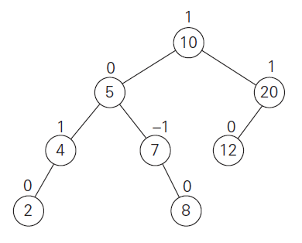
Solution
Yes, it’s an AVL tree because each node's balance factor is -1, 0, or 1.
  You may feel that the tree is not well balanced. But it’s an AVL based on the definition of AVL tree.

